Slide 1
Modern Steward
Authorts:
Lyubomir Yanchev Hristo Stoyanov

Slide 2
NOT GOING TO TALK ABOUT…

Slide 3
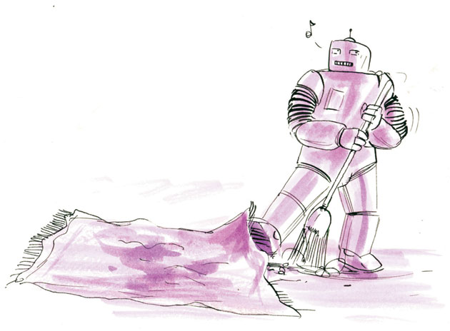

Slide 4
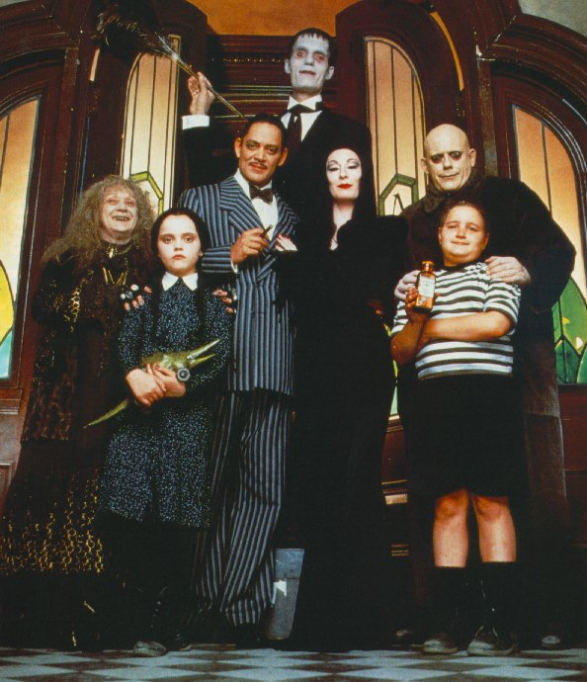
Close, but…

Slide 5

Or maybe it works?

Slide 6


Slide 7
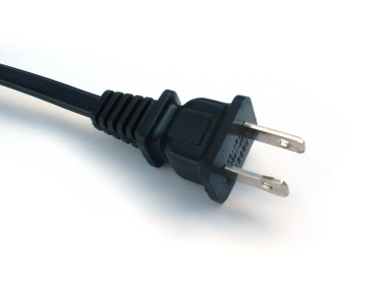
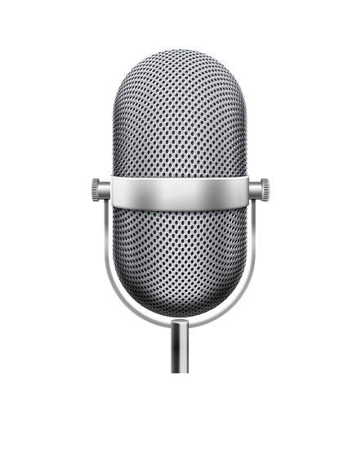


What?!
ModernSteward
Plugins
User
Notes:
Windows приложение, което посредством плъгини позволява вербалното контролиране с компютър и други периферни устройства.
Windows application, which enables the user to command verbally it’s computer and also other electronic devices

Slide 8
Graphical Interface
Triggering system
Core
Which plugin have to be triggered + additional information
Triggers the plugin
Plugins
Speech recognition
Grammar
Notes:
Както всяка друга програма, Модерният иконом има ядро, което се грижи за свързването на отделните модули. В нашия случай, ядрото предава на гласовото разпознаване граматиката на добавките и задейства гласовото разпознаване.
Like almost every other application, ModernSteward has a Core, which bonds all other modules. His job is to translate the plugin’s grammar into suitable structure for the speech recognition engine and activate the engine.

Slide 9
How to make a plugin?
grammar
action
code
plugin
Notes:
Процесът на създаване на добавка е максимално улеснен – чрез магьосника за добавки само с 4 стъпки може да се създаде готова за имплементиране на функционалност добавка.
The process of creating plugins is very easy – only with few steps (4) you can make your own plugin, which only has to implemented

Slide 10

You want some tee too?

Slide 11
What is the grammar?
Order
a
pizza
food
with
pepperoni
tomato
without
pepperoni
tomato
with
without
extra
extra
extra
extra
spice
spice
“must” element
eligible element
dictation element
Notes:
Граматиката е като изречението – има различни елементи, изпълняващи различни роли.
The grammar is like the common sentence – it has different building elements that are playing different roles. If we look further into this example, we can see that the sentence starts with a “must-element” “Order” and continues with “a”, which is a “eligable element” –we can weather say it or not. If we look at the right branch of this tree, we can see that we have a “dictation element”, which represents a fully eligible text.

Slide 12

Why Windows speech recognition?
№ | Name | Producer | Code | $
1 | Windows Speech Recognition | Microsoft | closed | 0$
2 | Dragon NaturallySpeaking | Nuance | open | 199.99$
3 | CMU Sphinx | Carnegie Mellon University | open | 0$

Slide 13
Isn’t it a bit dark in here?

Slide 14
Isn’t it a bit bright in here?

Slide 15
Comparison with other products
№ | Name | Electrical devices | Voice | Computer functions | All IR devices | $ | $ + devices | Code
1 | ModernSteward | √ | √ | √ | √ | 0$ | 200$ | open
2 | 4Control | √ | X | X | X | 1500$ | +7000$ | closed
3 | Smart Home systems | √ | X | X | X | ? | +4000$ | closed

Slide 16

Where to put it into practice?
Practically – Everywhere! Have you ever seen Iron man? Exactly!
Computer
Check the mail
Search in the web
control applications and etc.
In the home (it’s a steward after all):
Lamps!
Home devices (TV, air conditioner, etc.)
Who’s on the front door?
Social:
Blind and other people with disabilities
Hospitals, police stations and other national services
You can always develop your own fully functional plugin to comfort yourself as much as possible!

Slide 17
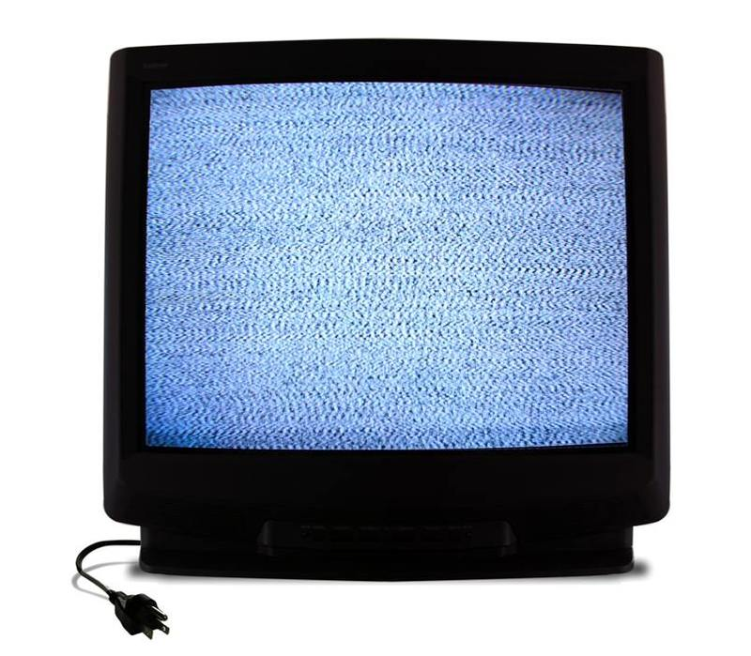
I wonder what’s on the TV now?

Slide 18


“Boring part”
C# .NET 4.0
Kiln & FogBugz
Telerik RadControls for WinForms
Windows Speech Recognition
Resources
Images: Robot
http://www.hemispheresmagazine.com/2010/07/01/robomop/
Adams family
http://drawninandquartered.wordpress.com/2011/10/02/kind-of-weird-but-like-the-addams-family-weird-huh/
Talking
http://www.flickr.com/photos/dilaudid/4954719152/
Cup
http://powic.deviantart.com/art/Tea-Cup-Icon-262160672 Telerik Logo
http://www.telerik.com/company/press-center.aspx
.NET Logo
http://en.wikipedia.org/wiki/File:NET_h_rgb_2.png
Kiln Logo
http://kiln.stackexchange.com/questions/4651/can-i-use-the-kiln-logo-for-my-presentation

Slide 19
Further development
CULang
Other platforms
Noise filtering
Own speech recognition
“rooms”
Internet interface
GSM control

Slide 20
Verbal commands
Open source
Easy to maintain
Controls practically everything!
For free!
Already in use.

Slide 21
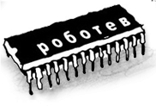

Thank you!

